Slide 1
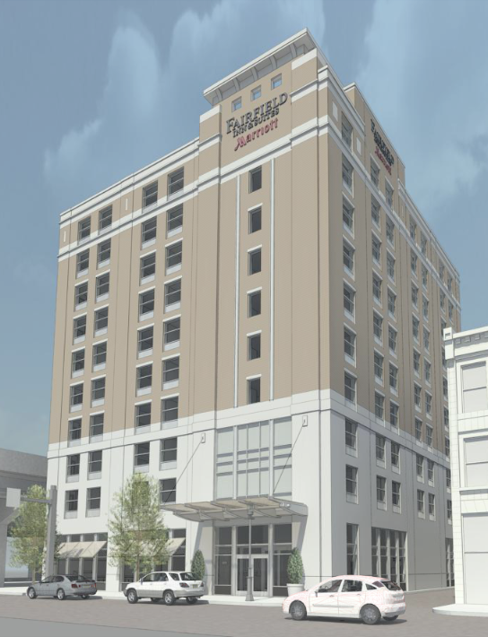
Fairfield Inn and Suites
Pittsburgh, PA
Amanda Smith Structural Option
AE Senior Thesis 2010 Advisor: Dr. Ali Memari

Slide 2
Fairfield Inn and Suites
Pittsburgh, PA
Presentation Outline
Existing Building Information
Project Goals
Structural Depth Study
  Gravity System
  Lateral Resisting System
  Foundation Impact
Façade Breadth Study
Construction Management Breadth Study
Conclusions and Recommendations
Acknowledgements

Slide 3
Fairfield Inn and Suites
Pittsburgh, PA
Existing Building Information
Project Goals
Structural Depth Study
  Gravity System
  Lateral Resisting System
  Foundation Impact
Façade Breadth Study
Construction Management Breadth Study
Conclusions and Recommendations
Acknowledgements
Existing Building Information
Amanda Smith Structural Option
AE Senior Thesis 2010 Advisor: Dr. Ali Memari

Slide 4
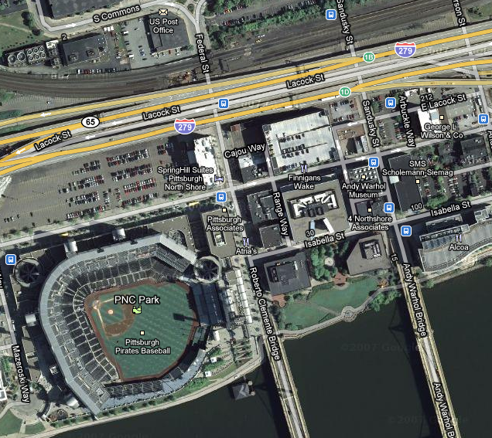
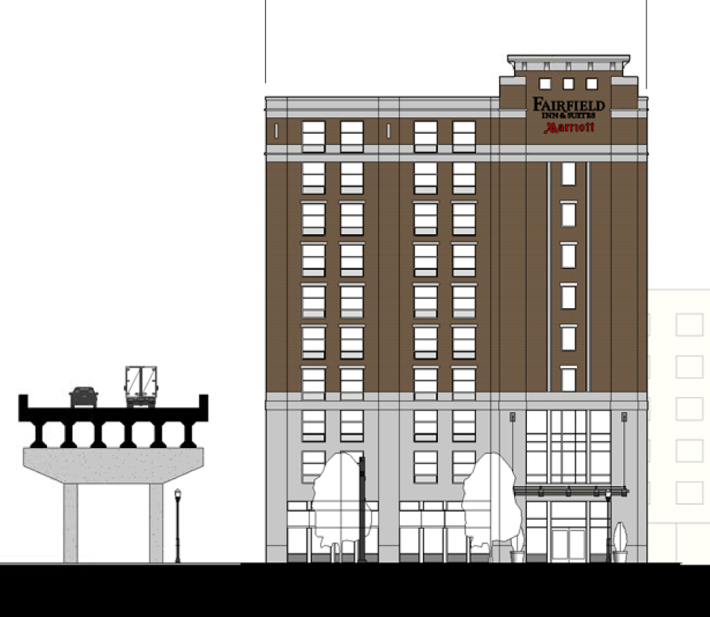
Fairfield Inn and Suites
Pittsburgh, PA
Existing Building Information
Project Goals
Structural Depth Study
  Gravity System
  Lateral Resisting System
  Foundation Impact
Façade Breadth Study
Construction Management Breadth Study
Conclusions and Recommendations
Acknowledgements
Location:
Downtown Pittsburgh
228 Federal St, Pittsburgh, PA
Building Statistics:
Occupancy - Hotel
Size – 80,000 SF
Stories – 10 stories above grade + 1 story below grade
Project Cost:
$19 million
Amanda Smith Structural Option
AE Senior Thesis 2010 Advisor: Dr. Ali Memari

Slide 5
Fairfield Inn and Suites
Pittsburgh, PA
Existing Building Information
Project Goals
Structural Depth Study
  Gravity System
  Lateral Resisting System
  Foundation Impact
Façade Breadth Study
Construction Management Breadth Study
Conclusions and Recommendations
Acknowledgements
Existing Structural System
Foundation:
Auger Cast Piles
  16” diameter
  Topped by concrete pilecaps
  Support 24”x24” reinforced concrete piers
Grade Beams
  36” to 48” depth
  Run between pilecaps
Amanda Smith Structural Option
AE Senior Thesis 2010 Advisor: Dr. Ali Memari

Slide 6
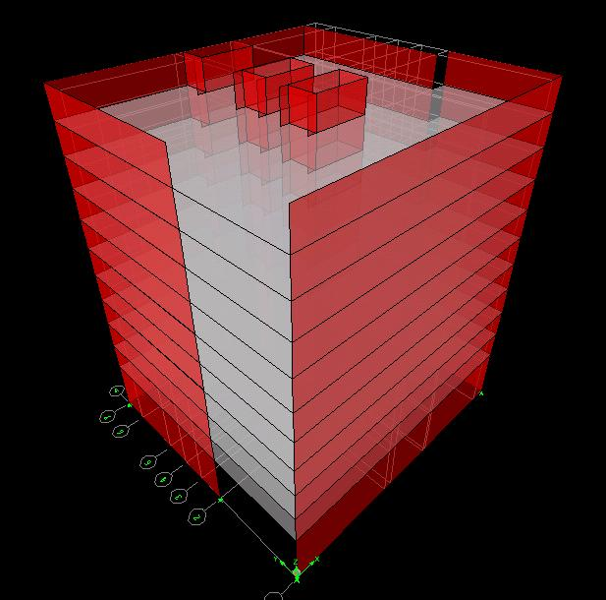
Fairfield Inn and Suites
Pittsburgh, PA
Existing Building Information
Project Goals
Structural Depth Study
  Gravity System
  Lateral Resisting System
  Foundation Impact
Façade Breadth Study
Construction Management Breadth Study
Conclusions and Recommendations
Acknowledgements
Existing Structural System
Gravity System:
Typically 8” precast concrete plank floor
Concrete masonry load bearing walls
Transfer Beams
Columns supporting lobby
Lateral Force Resisting System:
Concrete masonry shear walls
  10” thick walls around perimeter
  8” thick walls in core
Amanda Smith Structural Option
AE Senior Thesis 2010 Advisor: Dr. Ali Memari

Slide 7
Fairfield Inn and Suites
Pittsburgh, PA
Existing Building Information
Project Goals
Structural Depth Study
  Gravity System
  Lateral Resisting System
  Foundation Impact
Façade Breadth Study
Construction Management Breadth Study
Conclusions and Recommendations
Acknowledgements
Project Goals
Amanda Smith Structural Option
AE Senior Thesis 2010 Advisor: Dr. Ali Memari

Slide 8
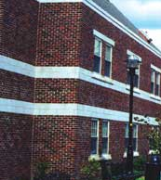
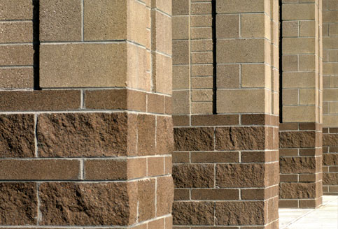
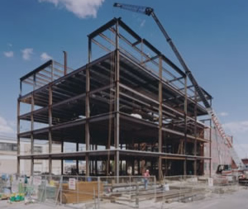
Fairfield Inn and Suites
Pittsburgh, PA
Existing Building Information
Project Goals
Structural Depth Study
  Gravity System
  Lateral Resisting System
  Foundation Impact
Façade Breadth Study
Construction Management Breadth Study
Conclusions and Recommendations
Acknowledgements
Problem Statement
Building Weight
  Poor Soil Site
  Load bearing walls
  High base shear value
Problem Solution
Design lighter structural system
  Steel Moment Frames
  Core CMU shear walls
Amanda Smith Structural Option
AE Senior Thesis 2010 Advisor: Dr. Ali Memari

Slide 9
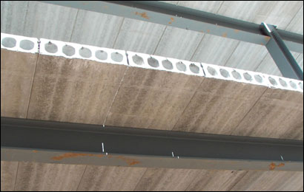
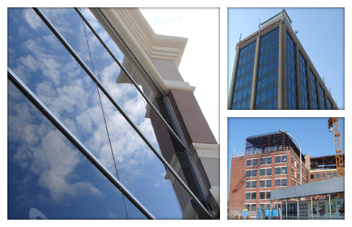
Fairfield Inn and Suites
Pittsburgh, PA
Existing Building Information
Project Goals
Structural Depth Study
  Gravity System
  Lateral Resisting System
  Foundation Impact
Façade Breadth Study
Construction Management Breadth Study
Conclusions and Recommendations
Acknowledgements
Project Goals
Structural Depth Study:
Reduce overall building weight by redesigning gravity system
Optimize the lateral force resisting system
Foundation check
Façade Breadth Study:
Effect of steel frame on façade
Construction Management Breadth Study:
Impact on construction schedule and cost
Amanda Smith Structural Option
AE Senior Thesis 2010 Advisor: Dr. Ali Memari

Slide 10
Fairfield Inn and Suites
Pittsburgh, PA
Existing Building Information
Project Goals
Structural Depth Study
  Gravity System
  Lateral Resisting System
  Foundation Impact
Façade Breadth Study
Construction Management Breadth Study
Conclusions and Recommendations
Acknowledgements
Structural Depth Study
Amanda Smith Structural Option
AE Senior Thesis 2010 Advisor: Dr. Ali Memari

Slide 11
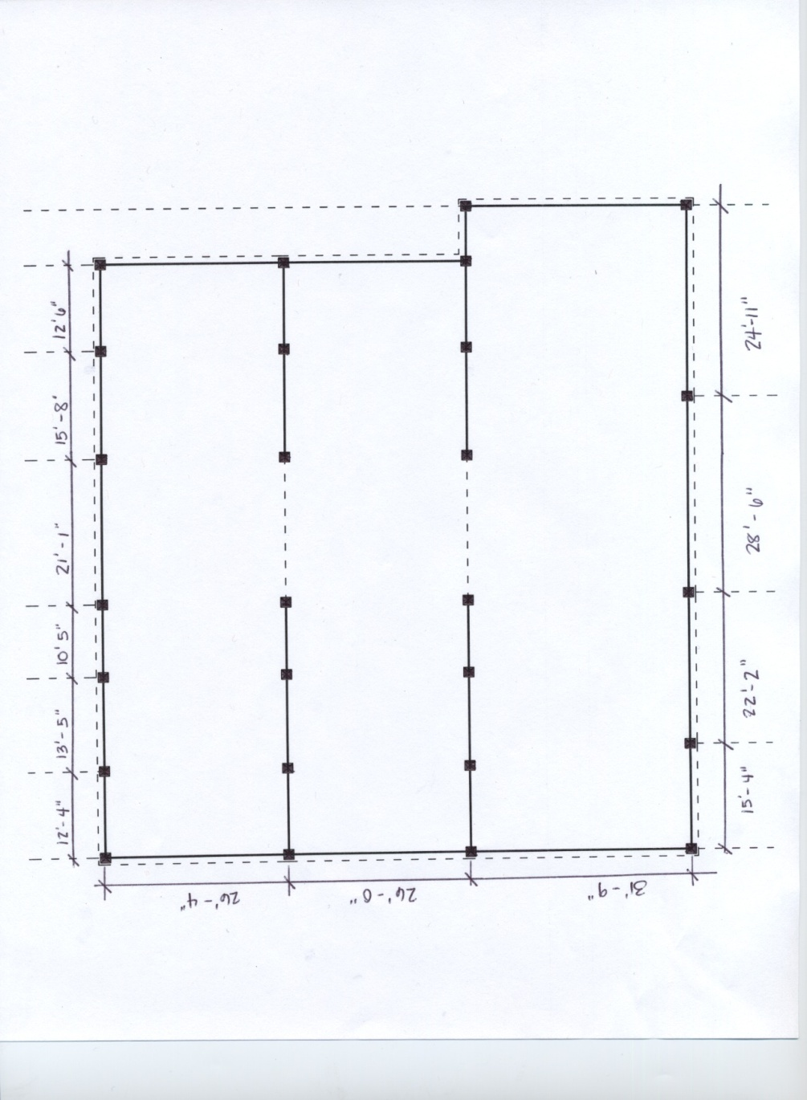
Fairfield Inn and Suites
Pittsburgh, PA
Existing Building Information
Project Goals
Structural Depth Study
  Gravity System
  Lateral Resisting System
  Foundation Impact
Façade Breadth Study
Construction Management Breadth Study
Conclusions and Recommendations
Acknowledgements
Framing Plan
Moment frames span E-W
Frames spaced at 26’ and 31’
Columns kept at existing locations
Columns added around the perimeter
Design Loads
ASCE 7-05
Live load values
Superimposed load values
Snow loads
Controlling Load Combination: 1.2D + 1.6L + 0.5Lr
N
Amanda Smith Structural Option
AE Senior Thesis 2010 Advisor: Dr. Ali Memari

Slide 12
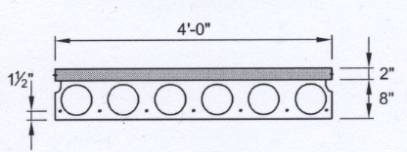
Fairfield Inn and Suites
Pittsburgh, PA
Existing Building Information
Project Goals
Structural Depth Study
  Gravity System
  Lateral Resisting System
  Foundation Impact
Façade Breadth Study
Construction Management Breadth Study
Conclusions and Recommendations
Acknowledgements
Hollow Core Plank Design
Live Load = 80 psf
Dead Load = 10 psf
SDL = 25 psf
Results using PCI Design Handbook:
  78 –S
    7 strands at 8/16” dia.
Max Span = 31’-8”
Normal weight concrete
Amanda Smith Structural Option
AE Senior Thesis 2010 Advisor: Dr. Ali Memari

Slide 13
Fairfield Inn and Suites
Pittsburgh, PA
Existing Building Information
Project Goals
Structural Depth Study
  Gravity System
  Lateral Resisting System
  Foundation Impact
Façade Breadth Study
Construction Management Breadth Study
Conclusions and Recommendations
Acknowledgements
Beam/Girder Design Criteria
Strength Design Criteria: ASCE 7-05 LRFD Load Combinations
1.4D
1.2D + 1.6L + 0.5(L_{r} or S)
1.2D + 1.6L_{r} + 0.5L
Serviceability Criteria: Deflection
Non-Composite:
Dead Load ………………………….l/360
Live Load …………………………...l/360
Total Load ………………………….l/240
Economy Criteria: Camber
do NOT camber: Beams that are less than 25ft
Beams that requires less that ¾” of camber
Amanda Smith Structural Option
AE Senior Thesis 2010 Advisor: Dr. Ali Memari

Slide 14
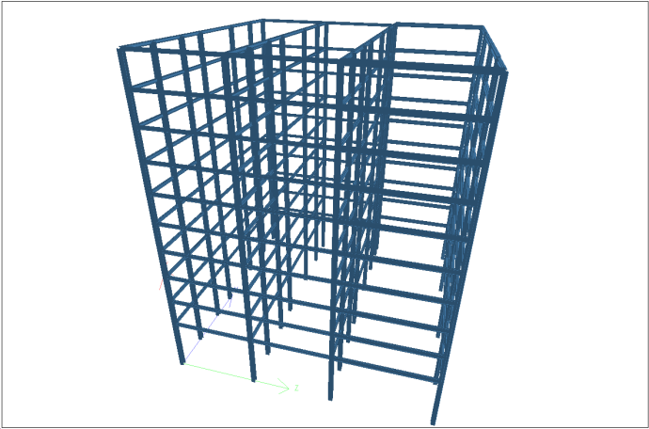
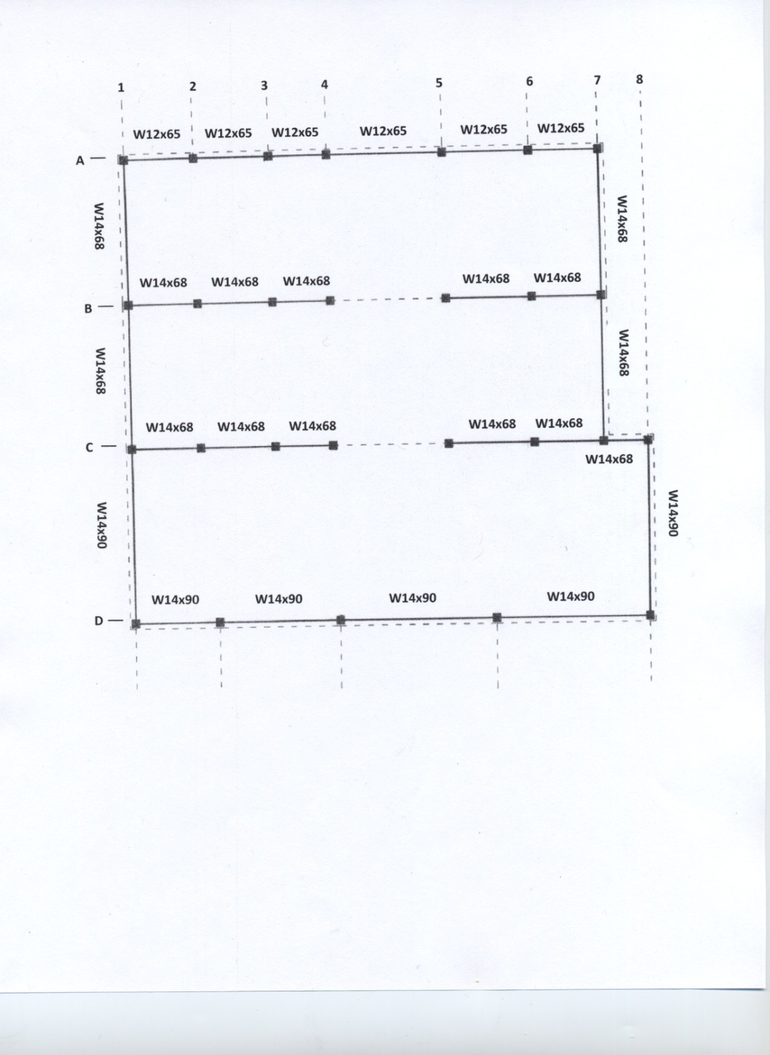
Fairfield Inn and Suites
Pittsburgh, PA
Existing Building Information
Project Goals
Structural Depth Study
  Gravity System
  Lateral Resisting System
  Foundation Impact
Façade Breadth Study
Construction Management Breadth Study
Conclusions and Recommendations
Acknowledgements
Beam/Girder Design
Optimal members were designed with Staad and checked by hand calculations
Example: Typical Girders
Amanda Smith Structural Option
AE Senior Thesis 2010 Advisor: Dr. Ali Memari

Slide 15
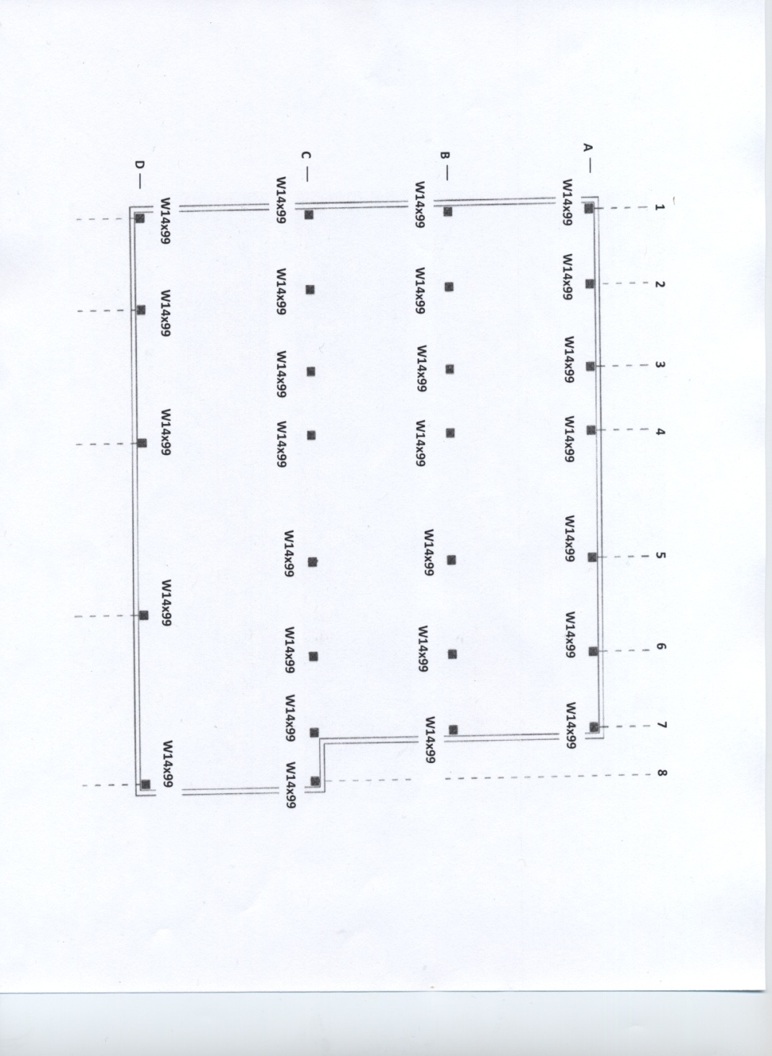
Fairfield Inn and Suites
Pittsburgh, PA
Existing Building Information
Project Goals
Structural Depth Study
  Gravity System
  Lateral Resisting System
  Foundation Impact
Façade Breadth Study
Construction Management Breadth Study
Conclusions and Recommendations
Acknowledgements
N
Column Design
Columns resist gravity loads only
  Levels 1 - 5: W14x176
  Levels 6-10: W14x99
Columns spliced at 5th story
Optimal members were determined by Staad and checked with hand calculations
Amanda Smith Structural Option
AE Senior Thesis 2010 Advisor: Dr. Ali Memari

Slide 16
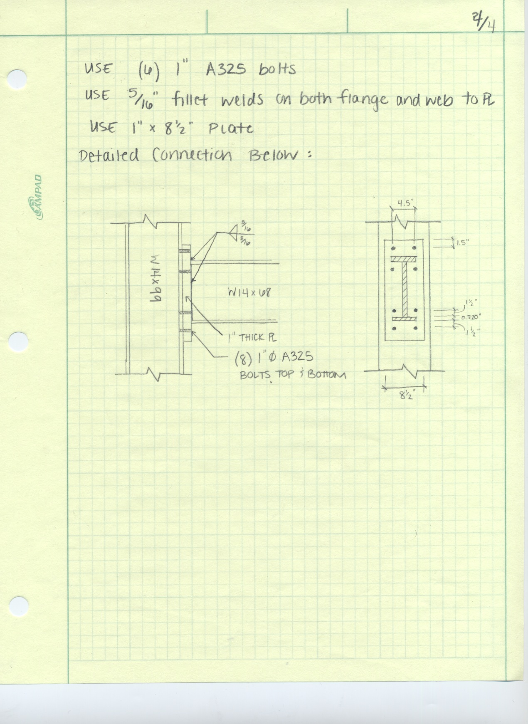
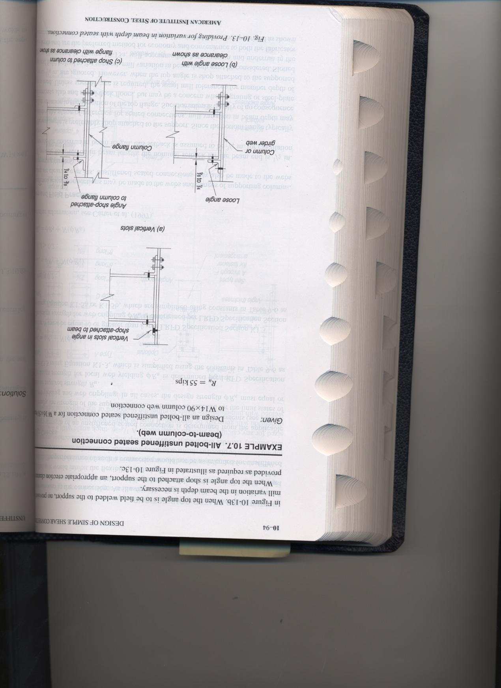
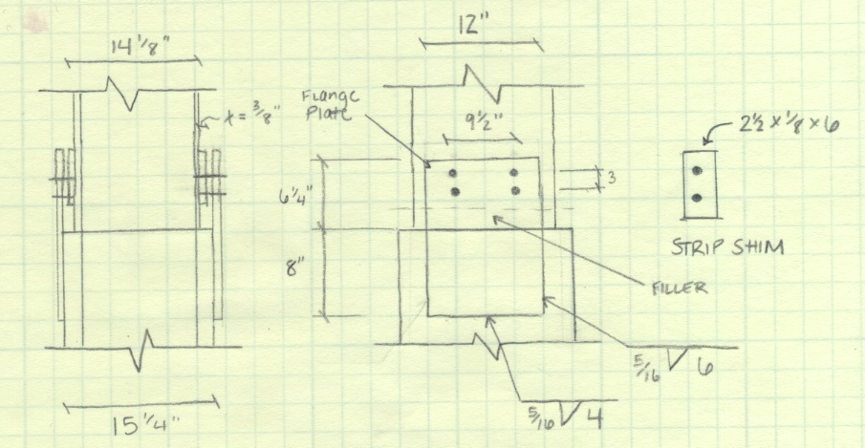
Fairfield Inn and Suites
Pittsburgh, PA
Existing Building Information
Project Goals
Structural Depth Study
  Gravity System
  Lateral Resisting System
  Foundation Impact
Façade Breadth Study
Construction Management Breadth Study
Conclusions and Recommendations
Acknowledgements
Connection Design
Moment Frame Connection
  4 bolt unstiffened extended end plate
  beam – column flange
Seated Connection
  all bolt unstiffened
  beam – column web
Column Splice Connection
  bolted and welded
Column base plate
Seated Connection
L 4x4x1/4 w/ 7/8” bolts
Moment Connection
Amanda Smith Structural Option
AE Senior Thesis 2010 Advisor: Dr. Ali Memari
Column Splice Connection

Slide 17
Fairfield Inn and Suites
Pittsburgh, PA
Existing Building Information
Project Goals
Structural Depth Study
  Gravity System
  Lateral Resisting System
  Foundation Impact
Façade Breadth Study
Construction Management Breadth Study
Conclusions and Recommendations
Acknowledgements
Impact on Lateral Loads
Seismic Loads control both directions
  31% decrease
Controlling Load Combination
  0.9D + 1.0E
Amanda Smith Structural Option
AE Senior Thesis 2010 Advisor: Dr. Ali Memari

Slide 18
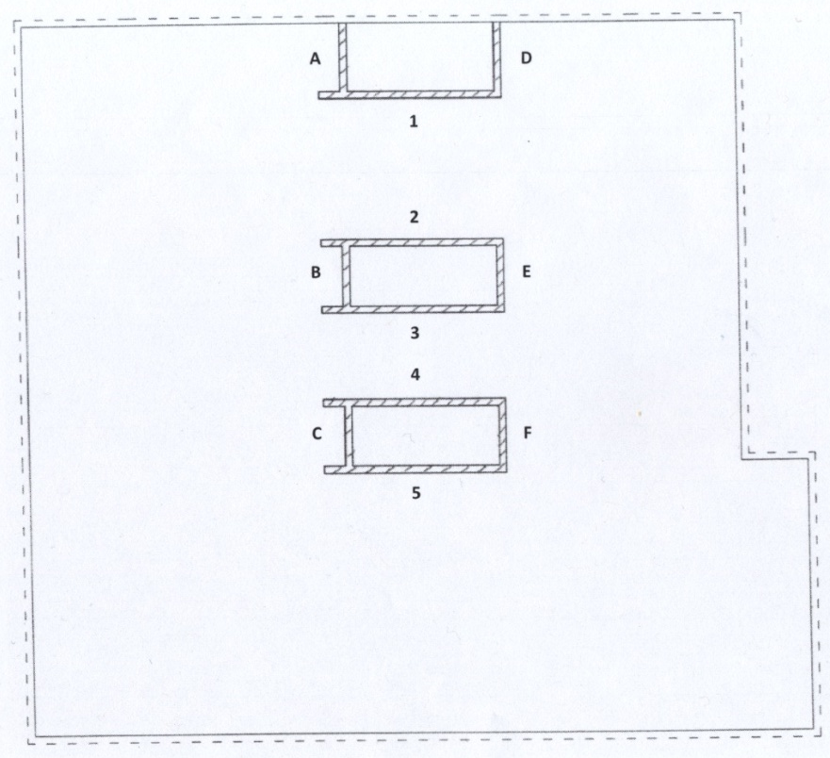
Fairfield Inn and Suites
Pittsburgh, PA
Existing Building Information
Project Goals
Structural Depth Study
  Gravity System
  Lateral Resisting System
  Foundation Impact
Façade Breadth Study
Construction Management Breadth Study
Conclusions and Recommendations
Acknowledgements
N
Shear Wall Design
Shear wall layout
Preliminary shear wall thickness = 10”
Amanda Smith Structural Option
AE Senior Thesis 2010 Advisor: Dr. Ali Memari

Slide 19
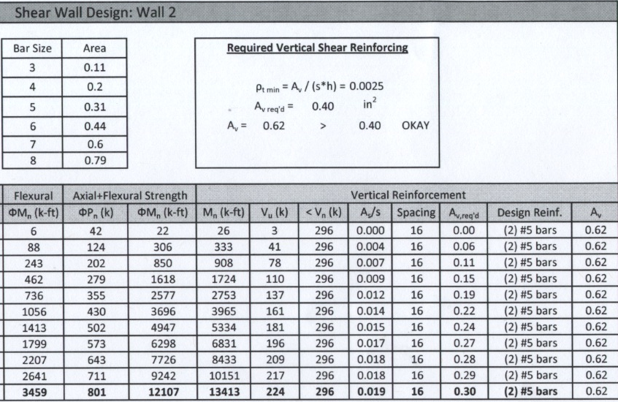
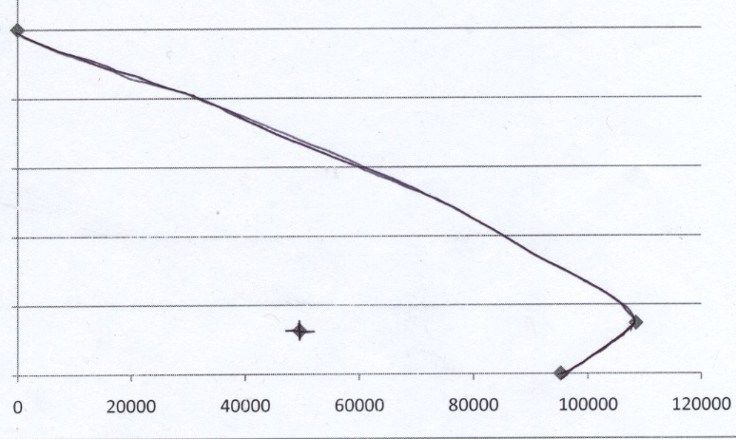
Fairfield Inn and Suites
Pittsburgh, PA
Existing Building Information
Project Goals
Structural Depth Study
  Gravity System
  Lateral Resisting System
  Foundation Impact
Façade Breadth Study
Construction Management Breadth Study
Conclusions and Recommendations
Acknowledgements
Shear Wall Design
Reinforcing:
  axial + flexural strength
  No horizontal shear reinforcement
  Vertical: #5 bars @ 8”, 16” & 32” O.C
Interaction Diagram
Amanda Smith Structural Option
AE Senior Thesis 2010 Advisor: Dr. Ali Memari

Slide 20
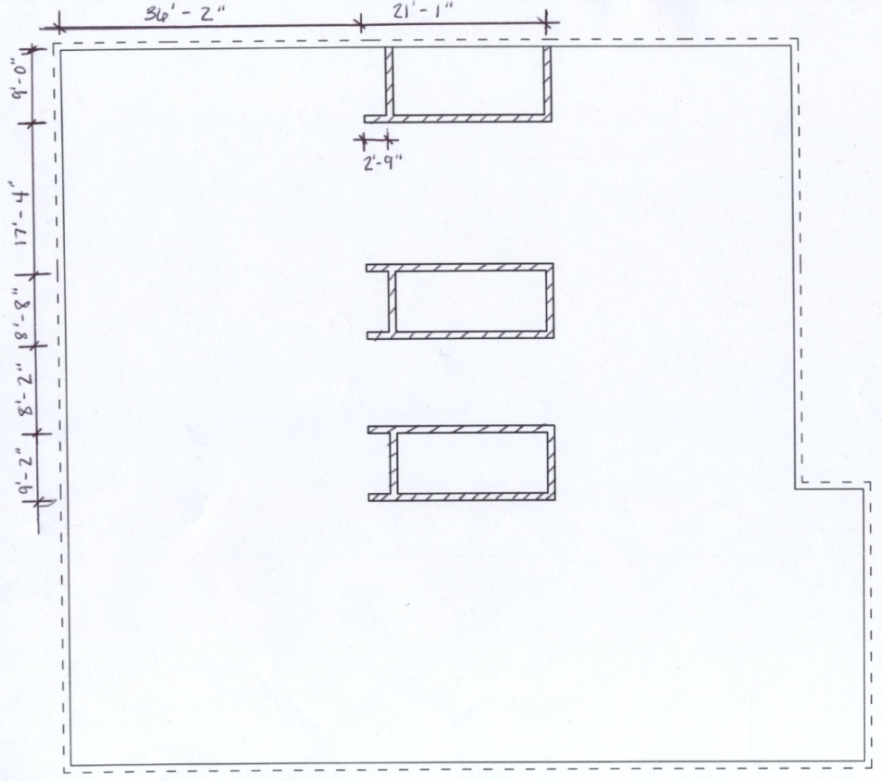
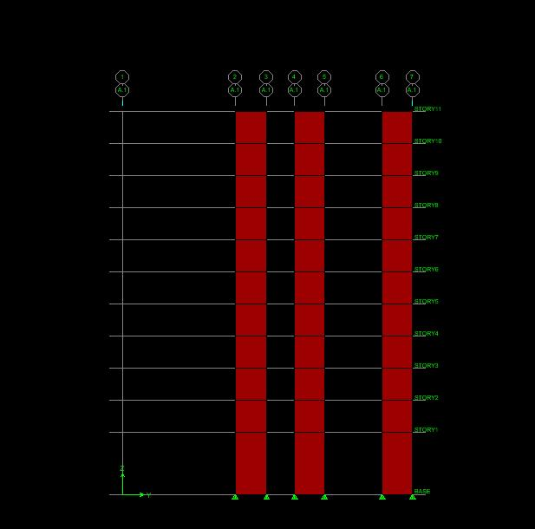
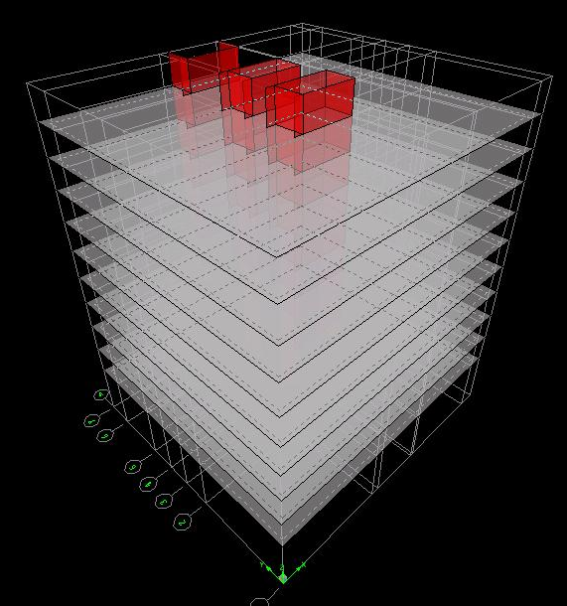
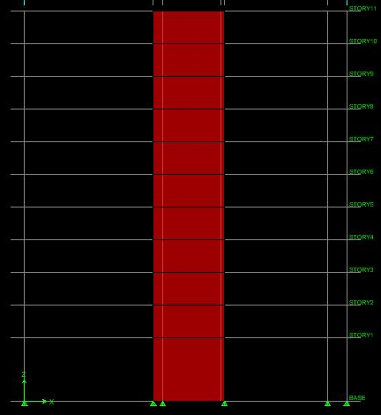
Fairfield Inn and Suites
Pittsburgh, PA
Existing Building Information
Project Goals
Structural Depth Study
  Gravity System
  Lateral Resisting System
  Foundation Impact
Façade Breadth Study
Construction Management Breadth Study
Conclusions and Recommendations
Acknowledgements
Optimization Study
Modified shear walls
  Thicker walls
  Additional reinforcement
ETABS Model
Assumptions:
  Shear wall take full lateral loads
  Floors modeled as rigid diaphragms
  Lateral loads distributed based on relative stiffness of each wall
  Gravity loads as additional area mass to the diaphragms
Amanda Smith Structural Option
AE Senior Thesis 2010 Advisor: Dr. Ali Memari

Slide 21
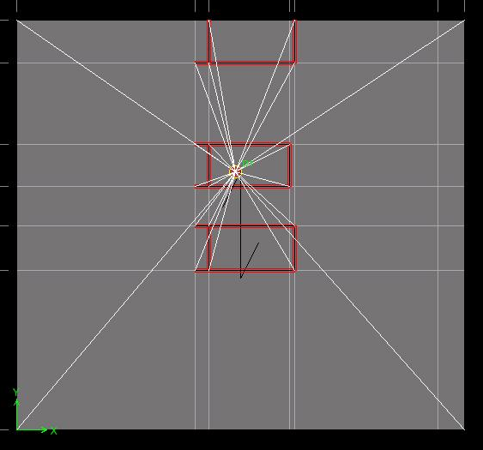
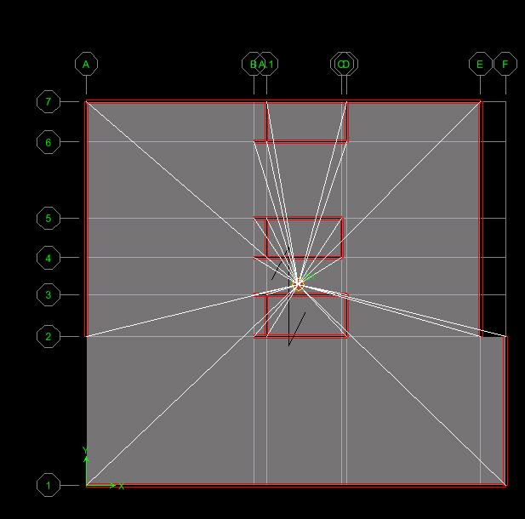
Fairfield Inn and Suites
Pittsburgh, PA
Existing Building Information
Project Goals
Structural Depth Study
  Gravity System
  Lateral Resisting System
  Foundation Impact
Façade Breadth Study
Construction Management Breadth Study
Conclusions and Recommendations
Acknowledgements
Optimization Study
Shift in center of rigidities
Increased stiffness to each shear wall
Decreased in Overall Building Torsion
Amanda Smith Structural Option
AE Senior Thesis 2010 Advisor: Dr. Ali Memari

Slide 22
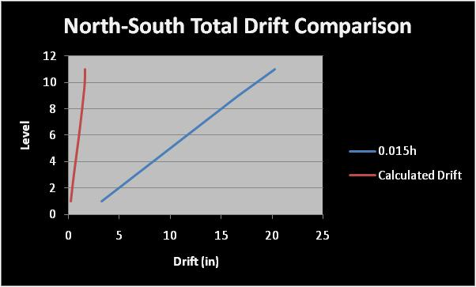
Fairfield Inn and Suites
Pittsburgh, PA
Existing Building Information
Project Goals
Structural Depth Study
  Gravity System
  Lateral Resisting System
  Foundation Impact
Façade Breadth Study
Construction Management Breadth Study
Conclusions and Recommendations
Acknowledgements
Optimization Study
Lateral Drifts
ASCE 7-05 calculated drifts
Drift Limitations:
  Wind - H/400
  Seismic - 0.015h_{sx}
Lateral drifts due to seismic loads governed
  Max. drift in N-S direction
Amanda Smith Structural Option
AE Senior Thesis 2010 Advisor: Dr. Ali Memari

Slide 23
Fairfield Inn and Suites
Pittsburgh, PA
Existing Building Information
Project Goals
Structural Depth Study
  Gravity System
  Lateral Resisting System
  Foundation Impact
Façade Breadth Study
Construction Management Breadth Study
Conclusions and Recommendations
Acknowledgements
Impact on Foundation
Modified lateral resisting system
New material for altered gravity load system
  Decrease in overall building weight
  Greater resistance to overturning
Amanda Smith Structural Option
AE Senior Thesis 2010 Advisor: Dr. Ali Memari

Slide 24
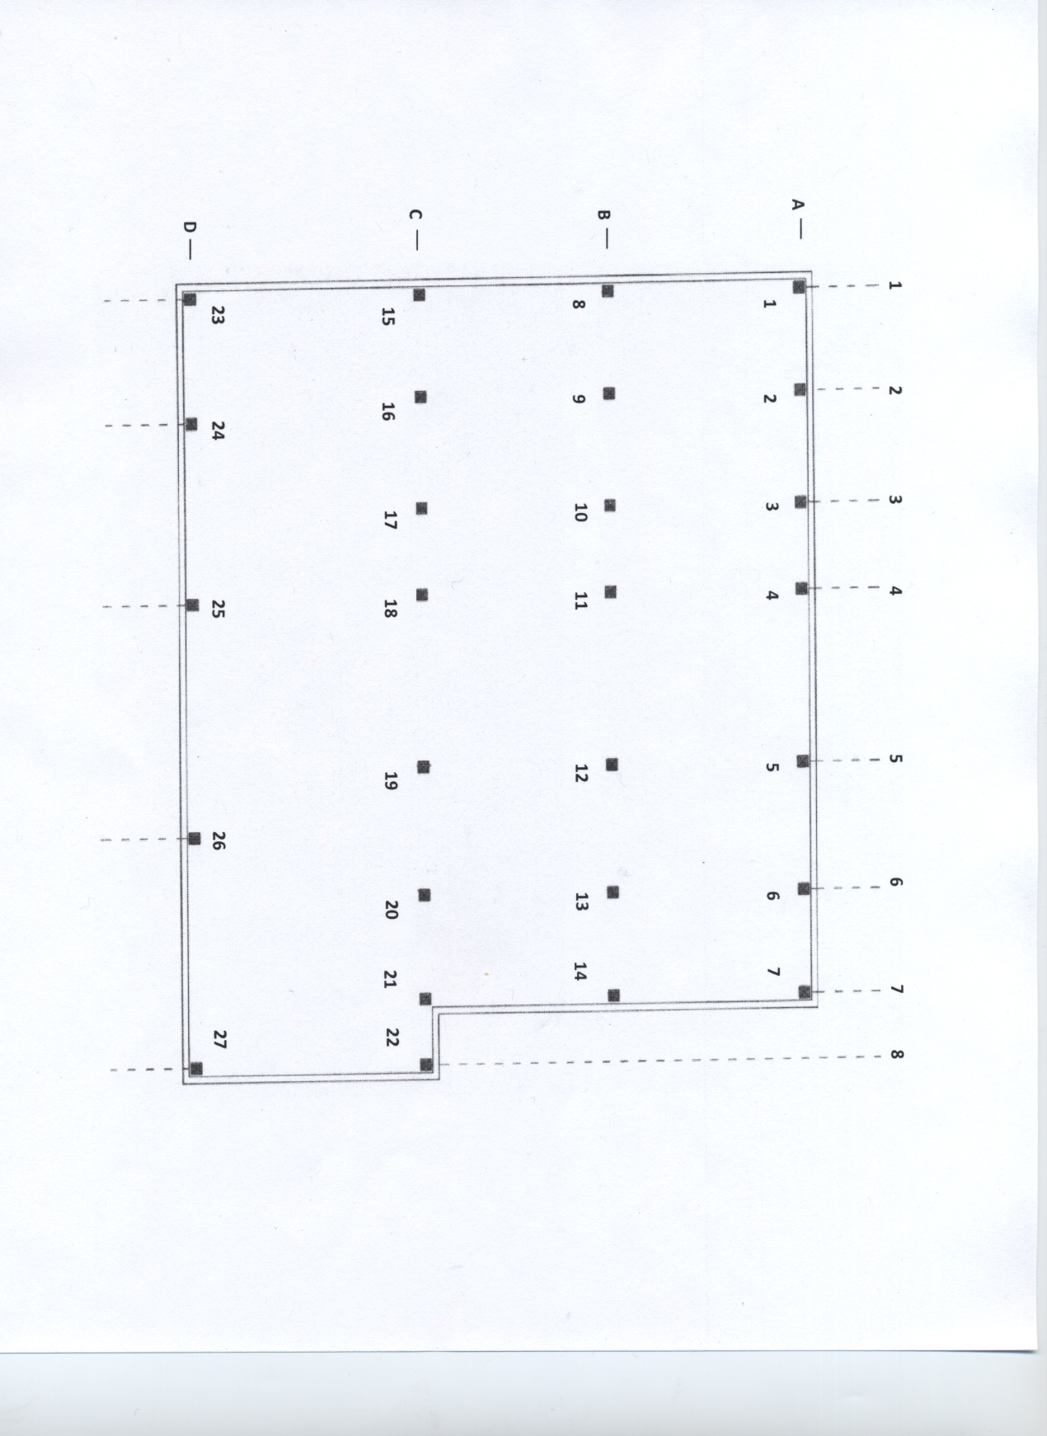
Fairfield Inn and Suites
Pittsburgh, PA
Existing Building Information
Project Goals
Structural Depth Study
  Gravity System
  Lateral Resisting System
  Foundation Impact
Façade Breadth Study
Construction Management Breadth Study
Conclusions and Recommendations
Acknowledgements
Impact on Foundation
Auger cast Piles
  16” diameter
Amanda Smith Structural Option
AE Senior Thesis 2010 Advisor: Dr. Ali Memari

Slide 25
Fairfield Inn and Suites
Pittsburgh, PA
Existing Building Information
Project Goals
Structural Depth Study
  Gravity System
  Lateral Resisting System
  Foundation Impact
Façade Breadth Study
Construction Management Breadth Study
Conclusions and Recommendations
Acknowledgements
Conclusions
Gravity System Redesign
  Strength
  Serviceability
  Reduction load bearing walls
  Reduced building weight
Modified Lateral Resisting System
  Reduced overall building torsion
  Within drift limits
Foundation
  Overturning resistance
  Reduced number of piles
Amanda Smith Structural Option
AE Senior Thesis 2010 Advisor: Dr. Ali Memari

Slide 26
Fairfield Inn and Suites
Pittsburgh, PA
Existing Building Information
Project Goals
Structural Depth Study
  Gravity System
  Lateral Resisting System
  Foundation Impact
Façade Breadth Study
Construction Management Breadth Study
Conclusions and Recommendations
Acknowledgements
Façade Breadth Study
Amanda Smith Structural Option
AE Senior Thesis 2010 Advisor: Dr. Ali Memari

Slide 27
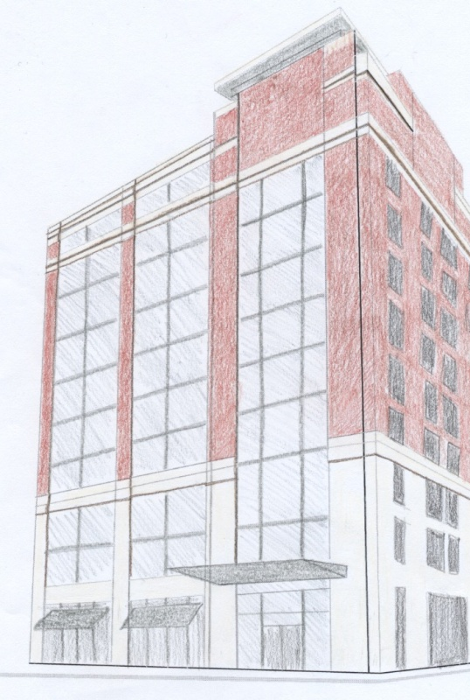
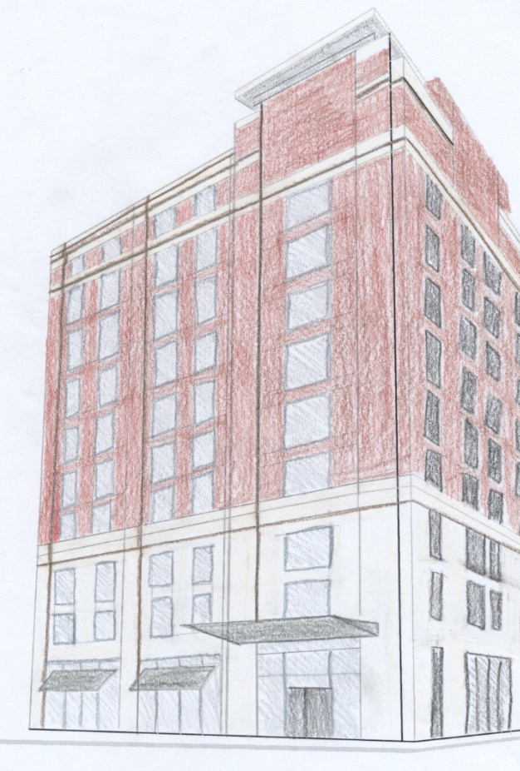
Fairfield Inn and Suites
Pittsburgh, PA
Existing Building Information
Project Goals
Structural Depth Study
  Gravity System
  Lateral Resisting System
  Foundation Impact
Façade Breadth Study
Construction Management Breadth Study
Conclusions and Recommendations
Acknowledgements
Façade Breadth Study
Amanda Smith Structural Option
AE Senior Thesis 2010 Advisor: Dr. Ali Memari

Slide 28
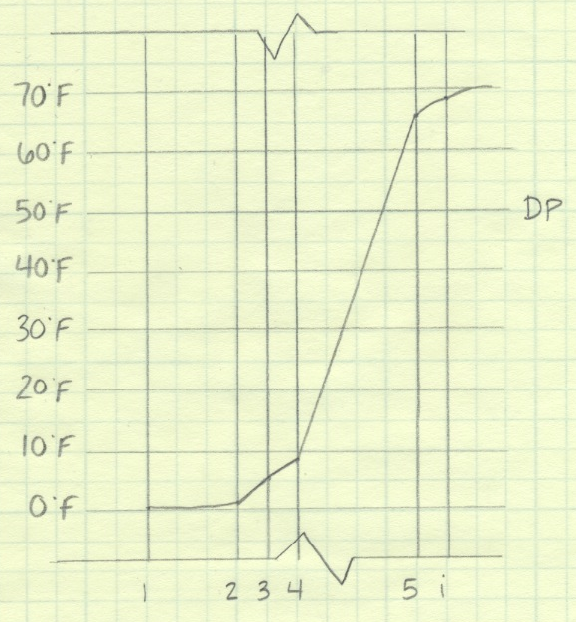
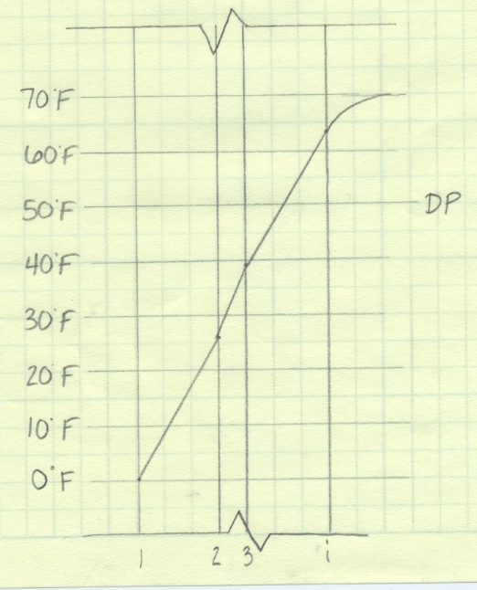
Fairfield Inn and Suites
Pittsburgh, PA
Existing Building Information
Project Goals
Structural Depth Study
  Gravity System
  Lateral Resisting System
  Foundation Impact
Façade Breadth Study
Construction Management Breadth Study
Conclusions and Recommendations
Acknowledgements
Thermal Gradients
Amanda Smith Structural Option
AE Senior Thesis 2010 Advisor: Dr. Ali Memari

Slide 29
Fairfield Inn and Suites
Pittsburgh, PA
Existing Building Information
Project Goals
Structural Depth Study
  Gravity System
  Lateral Resisting System
  Foundation Impact
Façade Breadth Study
Construction Management Breadth Study
Conclusions and Recommendations
Acknowledgements
Cost Comparison
Amanda Smith Structural Option
AE Senior Thesis 2010 Advisor: Dr. Ali Memari

Slide 30
Fairfield Inn and Suites
Pittsburgh, PA
Existing Building Information
Project Goals
Structural Depth Study
  Gravity System
  Lateral Resisting System
  Foundation Impact
Façade Breadth Study
Construction Management Breadth Study
Conclusions and Recommendations
Acknowledgements
Conclusions
Research façade options on steel framing
Determined brick veneer is the most efficient facade thru heat transfer
Determined brick veneer is the cost efficient facade
Amanda Smith Structural Option
AE Senior Thesis 2010 Advisor: Dr. Ali Memari

Slide 31
Fairfield Inn and Suites
Pittsburgh, PA
Existing Building Information
Project Goals
Structural Depth Study
  Gravity System
  Lateral Resisting System
  Foundation Impact
Façade Breadth Study
Construction Management Breadth Study
Conclusions and Recommendations
Acknowledgements
Construction Management Breadth Study
Amanda Smith Structural Option
AE Senior Thesis 2010 Advisor: Dr. Ali Memari

Slide 32
Fairfield Inn and Suites
Pittsburgh, PA
Existing Building Information
Project Goals
Structural Depth Study
  Gravity System
  Lateral Resisting System
  Foundation Impact
Façade Breadth Study
Construction Management Breadth Study
Conclusions and Recommendations
Acknowledgements
Construction Schedule
Redesigned Structural System
  Start Date: February 26, 2009
  Finish Date: April 24, 2009
Original Structural System
  Start Date: February 26, 2009
  Finish Date: August 13, 2009
Amanda Smith Structural Option
AE Senior Thesis 2010 Advisor: Dr. Ali Memari

Slide 33
Fairfield Inn and Suites
Pittsburgh, PA
Existing Building Information
Project Goals
Structural Depth Study
  Gravity System
  Lateral Resisting System
  Foundation Impact
Façade Breadth Study
Construction Management Breadth Study
Conclusions and Recommendations
Acknowledgements
Cost Impact of Redesigned System
Costs unaccounted for:
  Precast Plank floors
  Foundation costs
  Additional member connections
Example Detailed Cost Breakdown:
  Shear walls and reinforcement
  Steel members, base plates, fireproofing
  Crane
Amanda Smith Structural Option
AE Senior Thesis 2010 Advisor: Dr. Ali Memari

Slide 34
Fairfield Inn and Suites
Pittsburgh, PA
Existing Building Information
Project Goals
Structural Depth Study
  Gravity System
  Lateral Resisting System
  Foundation Impact
Façade Breadth Study
Construction Management Breadth Study
Conclusions and Recommendations
Acknowledgements
Cost Impact
Amanda Smith Structural Option
AE Senior Thesis 2010 Advisor: Dr. Ali Memari

Slide 35
Fairfield Inn and Suites
Pittsburgh, PA
Existing Building Information
Project Goals
Structural Depth Study
  Gravity System
  Lateral Resisting System
  Foundation Impact
Façade Breadth Study
Construction Management Breadth Study
Conclusions and Recommendations
Acknowledgements
Conclusions
Steel erection tops out 30 days earlier than the new structural system
Structural system construction tops out 99 days earlier than existing structural system
Amanda Smith Structural Option
AE Senior Thesis 2010 Advisor: Dr. Ali Memari

Slide 36
Fairfield Inn and Suites
Pittsburgh, PA
Existing Building Information
Project Goals
Structural Depth Study
  Gravity System
  Lateral Resisting System
  Foundation Impact
Façade Breadth Study
Construction Management Breadth Study
Conclusions and Recommendations
Acknowledgements
Gravity System Redesign
Steel Moment Frames
  Reasonable design for gravity loads
  Meets strength and serviceability requirements
  Reduced overall building weight
Lateral Resisting System Redesign
Modified Shear wall design is optimal
Foundation
No alteration needed
Façade
Brick veneer is most efficient
Construction Management
Reduce schedule
Increase cost
Conclusions & Recommendations
Amanda Smith Structural Option
AE Senior Thesis 2010 Advisor: Dr. Ali Memari

Slide 37
Fairfield Inn and Suites
Pittsburgh, PA
Existing Building Information
Project Goals
Structural Depth Study
  Gravity System
  Lateral Resisting System
  Foundation Impact
Façade Breadth Study
Construction Management Breadth Study
Conclusions and Recommendations
Acknowledgements
Atlantic Engineering Services:
  Tim Jones
  Robert Bertocchi
Massaro Corporation:
  Brian Miller
G.M.McCrossin Contracting:
  Shawn Steward
SNC-Lavalin America:
  Jeremy Coulombe
The Pennsylvania State University:
  Dr. Ali Memari
  Prof. M Kevin Parfitt
  Prof. Robert Holland
  The entire AE faculty and staff
My friends and family for all their continued support.
Acknowledgements
Amanda Smith Structural Option
AE Senior Thesis 2010 Advisor: Dr. Ali Memari

Slide 38
Fairfield Inn and Suites
Pittsburgh, PA
Existing Building Information
Project Goals
Structural Depth Study
  Gravity System
  Lateral Resisting System
  Foundation Impact
Façade Breadth Study
Construction Management Breadth Study
Conclusions and Recommendations
Acknowledgements
Questions & Comments
Amanda Smith Structural Option
AE Senior Thesis 2010 Advisor: Dr. Ali Memari

